Slide 1


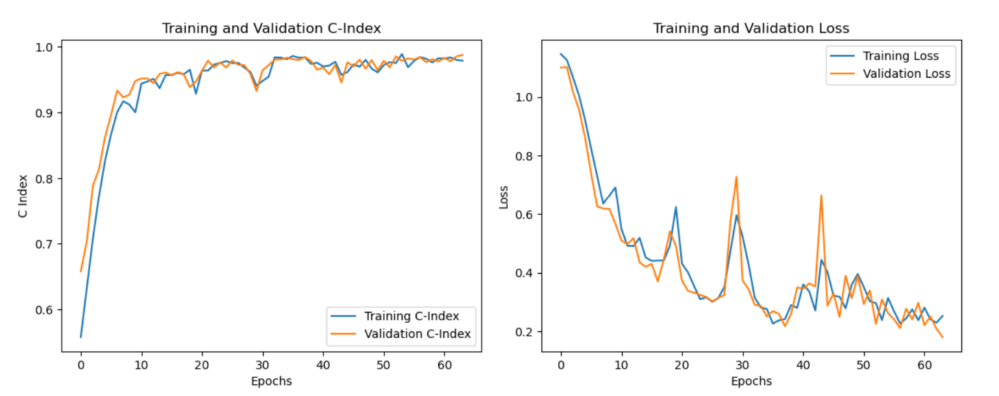
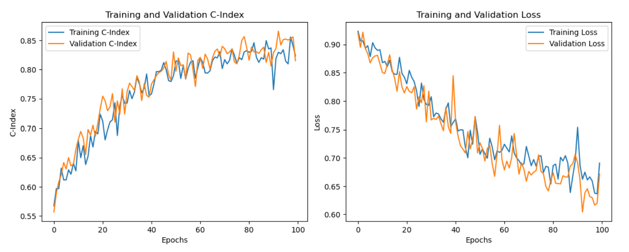
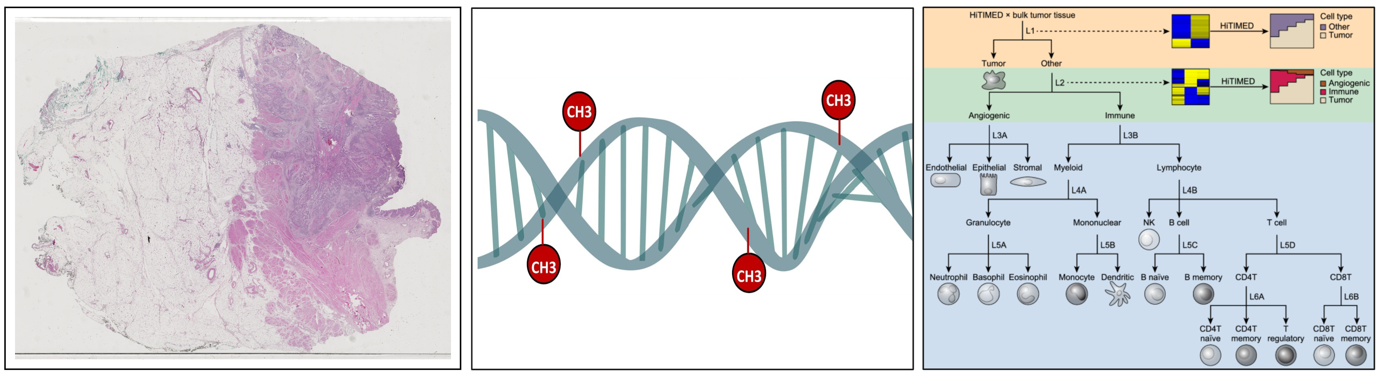
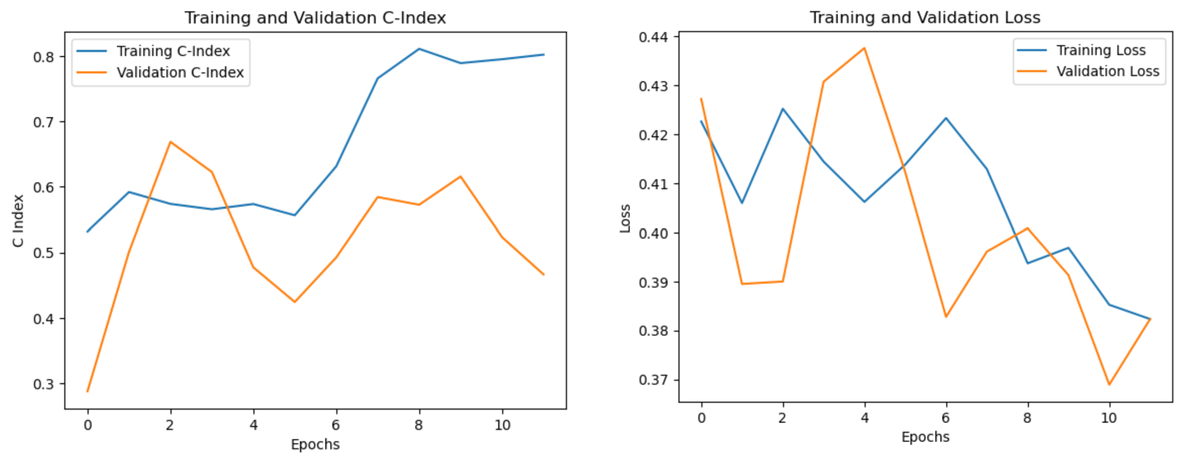
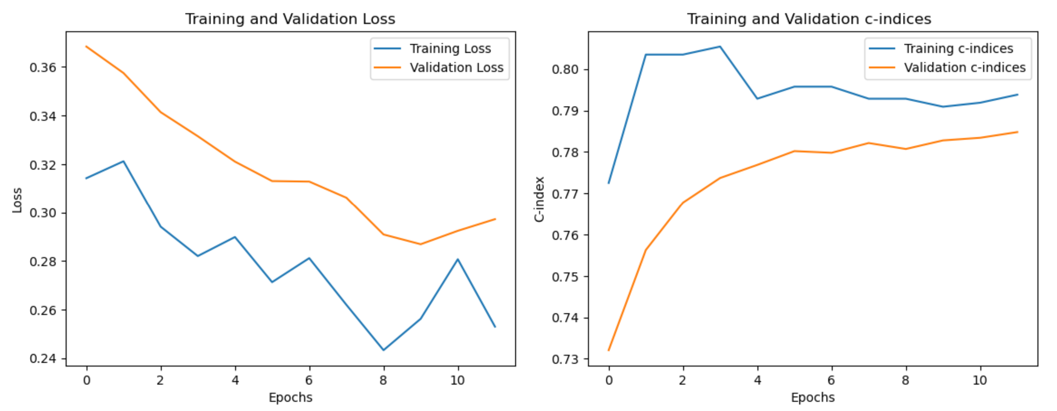
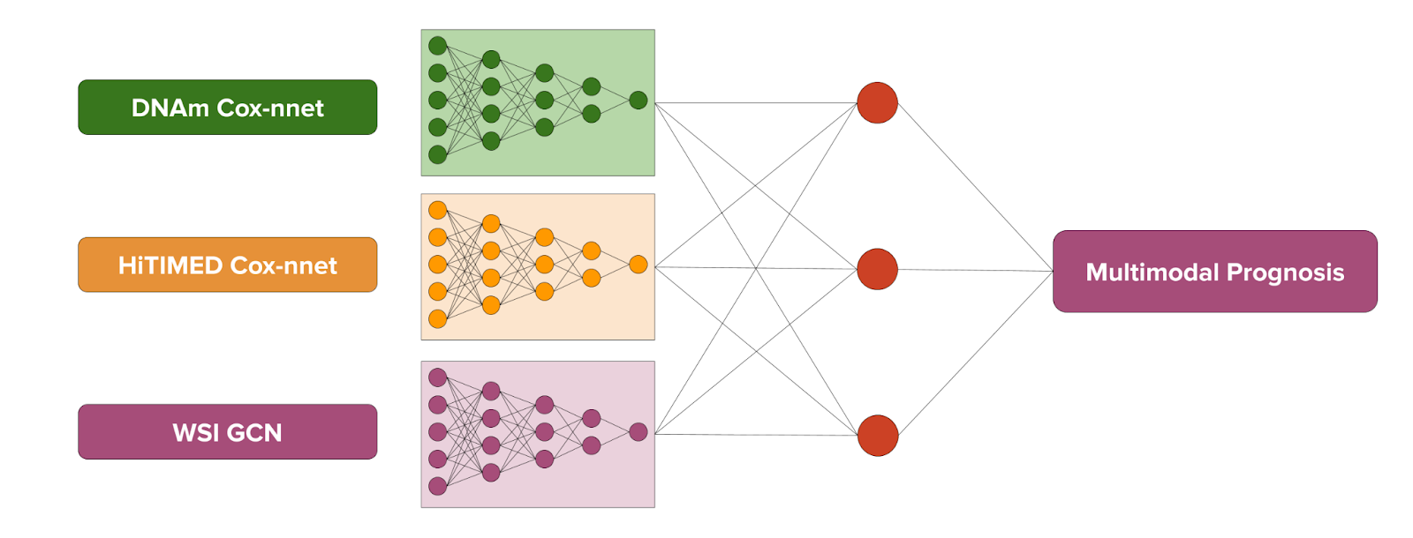
A Multimodal Machine Learning Model to Predict Death Hazards for Bladder Cancer Patients
Tristan Devictor
Thomas Jefferson High School for Science and Technology Computer Systems Lab, 2023-24
ABSTRACT
METHODS
RESULTS
Multimodal machine learning models are promising computational tools for can-cer prognostication. In cancer testing and treatment, patients tend to have multiple data types collected rather than just one. Whereas traditional unimodal models use one data type to make a prognostication, multimodal models capitalize on the availability of several data types for a single patient in order to generate a more informed—and accurate—prediction. This study aimed to develop a multimodal model for predicting the recurrence hazard bladder cancer patients face, taking into account three data modalities: DNA methylation (DNAm) profiles, tumor micro-environment cell type deconvolution data, and whole slide images of blad-der tissue. However, it lacked access to patients’ recurrence data due to confiden-tiality issues and therefore developed models predicting the hazard of death, with the aim of using the same workflow for recurrence prediction. It developed a unimodal neural network for DNAm profile data, which reached a Concordance index (C-index) of 0.731, then developed a unimodal model for tumor cell type data (HiTIMED), which reached a C-index of 0.639. Finally, it created a unimodal graph convolutional network (GCN) trained on whole slide image (WSI) data, which reached a C-index of 0.588. It then developed a multimodal model taking the pen-ultimate layers of each of these unimodal models as input. The final multimodal model achieved a C-index of 0.798, indicating a strong model. The project’s future course of study is to adjust the input layers of the multimodal model to improve the final C-index.
The present study drew upon three distinct data modalities. The first was the degree of methylation at specific DNA sites (CpG islands), a natural biological process that, when irregular, can provide insight into the development of a patient’s cancer. The data contained values ranging from 0 to 1 for 280,257 CpG sites in each of 396 patients. The second data type—derived from the DNAm profiles using the HiTIMED algorithm developed by Zhang et al. (2022)—was on the cell type proportions of a patient’s tumor and was available for 456 patients. HiTIMED data are an important tool in this analysis because different cell type compositions have been associated with distinct cancer prognoses (Zhang et al., 2022). The final input modality was the whole slide imagery of cancerous bladder tissue, which was available for 440 patients. Each image was divided into about 25,000 patches of 224 pixels x 224 pixels.
Fig. 1. Visualizations of Each Data Modality (WSI, DNAm, and HiTIMED, from left to right)
This study trained a multilayer perceptron (MLP) Cox-nnet model (an extension of the Cox regression model, implemented using PyTorch) on the DNAm data as well as the HiTIMED data to predict patients’ hazard of death. It attempted to create a variational autoencoder (VAE) to compress the DNAm data from 280,257 values per patient to only 256. The VAE was trained using a mean-squared error loss, calculated after reconstructing the original data from the compressed output. However, the VAE did not improve the DNAm MLP.
The present study also trained a unimodal GCN on the WSIs. It first created vector embeddings using a pre-trained ResNet-50 to compress each patch into simpler arrays of 1024 summarizing features. It then aggregated each of these embeddings into graph data structures to capitalize on the location and connectivity of each feature vector. It then trained the GCN using these graphs.
Each of the models’ accuracy was evaluated using the Concordance index (C-index), which is calculated by comparing pairs of patients in which at least one patient has died; the model is considered to have calculated a pair of patients concordantly if it assigned a lower risk to the patient who survived longer. The C-index, ranging from 0 to 1, is determined by dividing the number of concordant pairs by the total number of pairs evaluated.
The final step of the project was to create the multimodal model, which took an aggregation of the outputs of the penultimate layers of each unimodal model as input.
Fig. 2. Structure of the Multimodal Machine Learning Model
The unimodal DNAm MLP (without the VAE) achieved a final testing C-index of 0.731. The unimodal HiTIMED MLP achieved a final testing C-index of 0.639. The unimodal WSI GCN achieved a final testing C-index of 0.588. The multi-modal model achieved a final testing C-index of 0.798.
Fig. 3. C-index and Cox Loss of the Unimodal Models During Training
Fig. 4. C-index and Cox Loss of the Multimodal Model During Training
DNAm MLP
HiTIMED MLP
WSI GCN
Multimodal Model
INTRODUCTION
Bladder cancer patients are extremely prone to recurrence: depending on risk factors, 31% to 78% of patients see their cancer recur within five years of their initial treatment (Shen et al., 2016). Investigations to predict the hazard of recur-rence for specific patients can thus be crucial for medical prognoses and for determining the best courses of treatment.
Multimodal machine learning models are an increasingly relevant ap-proach for predicting medical outcomes. They capitalize on the tendency for patients to have multiple types of data collected during initial diagnoses and later follow-up screenings. By combining the capabilities of three unimodal machine learning models that are each trained on a distinct input data type—or modality—and therefore incorporating a wider array of data, this study sought to achieve more accurate predictions of bladder cancer recurrence. It also used readily available and common forms of data—WSIs of cancerous bladder tissue, DNAm profiles, and HiTIMED data—to facilitate the deployment of the model.
Previous studies have generated multimodal models for predicting cancer patients’ recurrence and survival hazards. Yang et al. (2022) constructed a suc-cessful multimodal model predicting recurrence in breast cancer patients. Azher et al. (2021) achieved increased accuracy in cancer prognostication by integrating unimodal models into a multimodal model.
However, no such analyses have been conducted for bladder cancer prog-noses. A comprehensive review of bladder cancer prognostication research by Kluth et al. (2015) did not discuss multimodal approaches: this is an emerging field of study.
CONCLUSION
The present study demonstrates that it is possible to create a multimodal model to predict bladder cancer survival based on DNAm, HiTIMED, and WSI data. It achieved a final C-index of 0.798, which is indicative of a strong model, and may contribute to real-world clinical medical prognoses for patients.
Future works may aim to improve this C-index by adjusting which layer of each of the unimodal models is used as the input of the multimodal model. It may be advantageous to use the third-to-last or fourth-to-last layers, rather than the penultimate layer, as these are larger and hence contain more features for the multimodal model to work from. Future studies may also aim to improve the present analysis by adding a fourth unimodal element. Correlations may exist between more commonly collected pieces of clinical data (blood type, dietary habits, smoking habits, etc.) and probabilities of death or recurrence.
Future works may also build upon the current research by shifting from survival to recurrence prediction using the same framework and workflow.

